Slide 1
Audio processing using Matlab
Elena Grassi

Slide 2
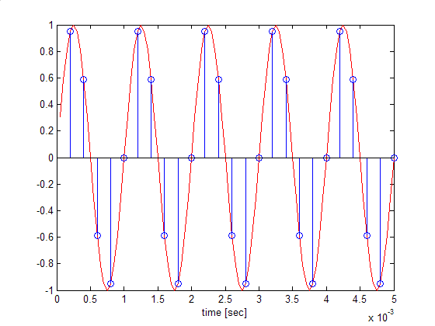
Sampling
Read values from a continuous signal
Equally spaced time interval (sampling frequency)

Slide 3
A/D (analog in/digital out)
AI = analoginput('winsound');
addchannel(AI,1);
set(AI,'SampleRate',44100)
set(AI,'SamplesPerTrigger',4*44100)
set(AI,'TriggerType','Manual')
start(AI)
trigger(AI)
data = getdata(AI);
delete(AI), clear AI

Slide 4
Spectrogram
Short time Fourier transform
Tradeoff frequency/time resolution.
Note: dB= 20*log10 ()
specgram(y, 256, fs)
title('Spectrogram [dB]')

Slide 5
D/A (digital in/analog out)
AO = analogoutput('winsound');
addchannel(AO,1);
set(AO,'SampleRate',22050)
set(AO,'TriggerType','Manual')
putdata(AO,x)
start(AO)
trigger(AO)
waittilstop(AO,5)
delete(AO), clear AO

Slide 6
Aliasing
When sampling is too slow for a signal’s BW, high frequency content cannot be observed and it leaks into lower frequencies, thus distorting the signal.
Minimum sampling required to capture the signal accurately:
Nyquist frequency= 2*BW
If not possible, apply antialiasing filter.

Slide 7
Filters
Modify frequency content of signals.
Classification according to their pass/stop bands:
Lowpass (smoothing filter)
Highpass
Bandpass
Stopband
Specify corner frequency(ies), normalized wrt ½ sampling frequency. Example: 2000/(fs/2) for 2000 Hz.

Slide 8
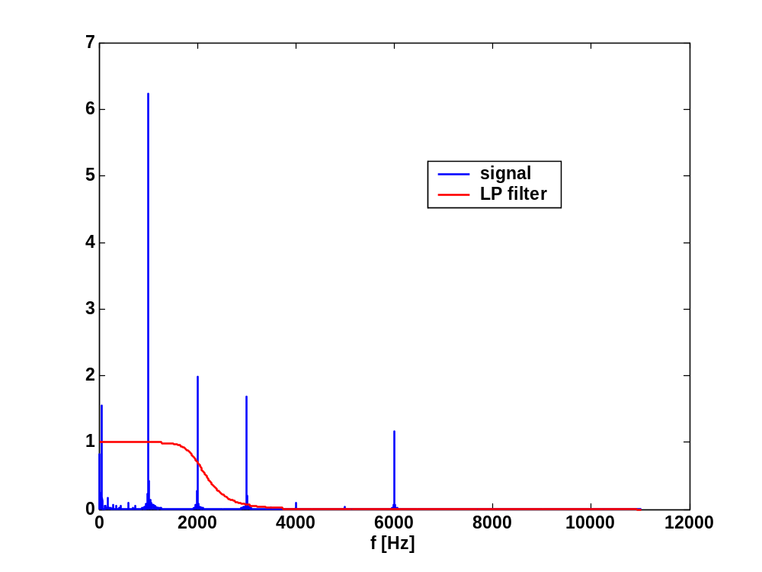
Example

Slide 9
Filter Types
Classification according to their roll-off, flatness, phase:
Bessel: linear phase, preserves wave shape.
Butterworth: flat and monotonic, sacrifice roll-off steepness.
Chebyshev I: equiripple in passband and monotonic in stopband.
Chebyshev II: monotonic in passband and equiripple in stopband, roll off slower than type I.

Slide 10
Example
[b,a]= butter(6,2000*2/fsi,'low');
sampling freq
order
corner freq
b= numerator polynomial in z
a= denominator polynomial in z

Slide 11
Filter frequency response
h= impz(b,a,N);
H=(abs(fft(h)));
fscale= fsi/N*(1:N/2);
plot(fscale,H(1:N/2),'r')
xlabel('f [Hz]')
title('Filter frequency response')

Slide 12
Filter order
Related to complexity (hardware or numerical) and how many samples of data are used.
Higher order <-> Steepness
Trade off with complexity/numerical stability

